Slide 1

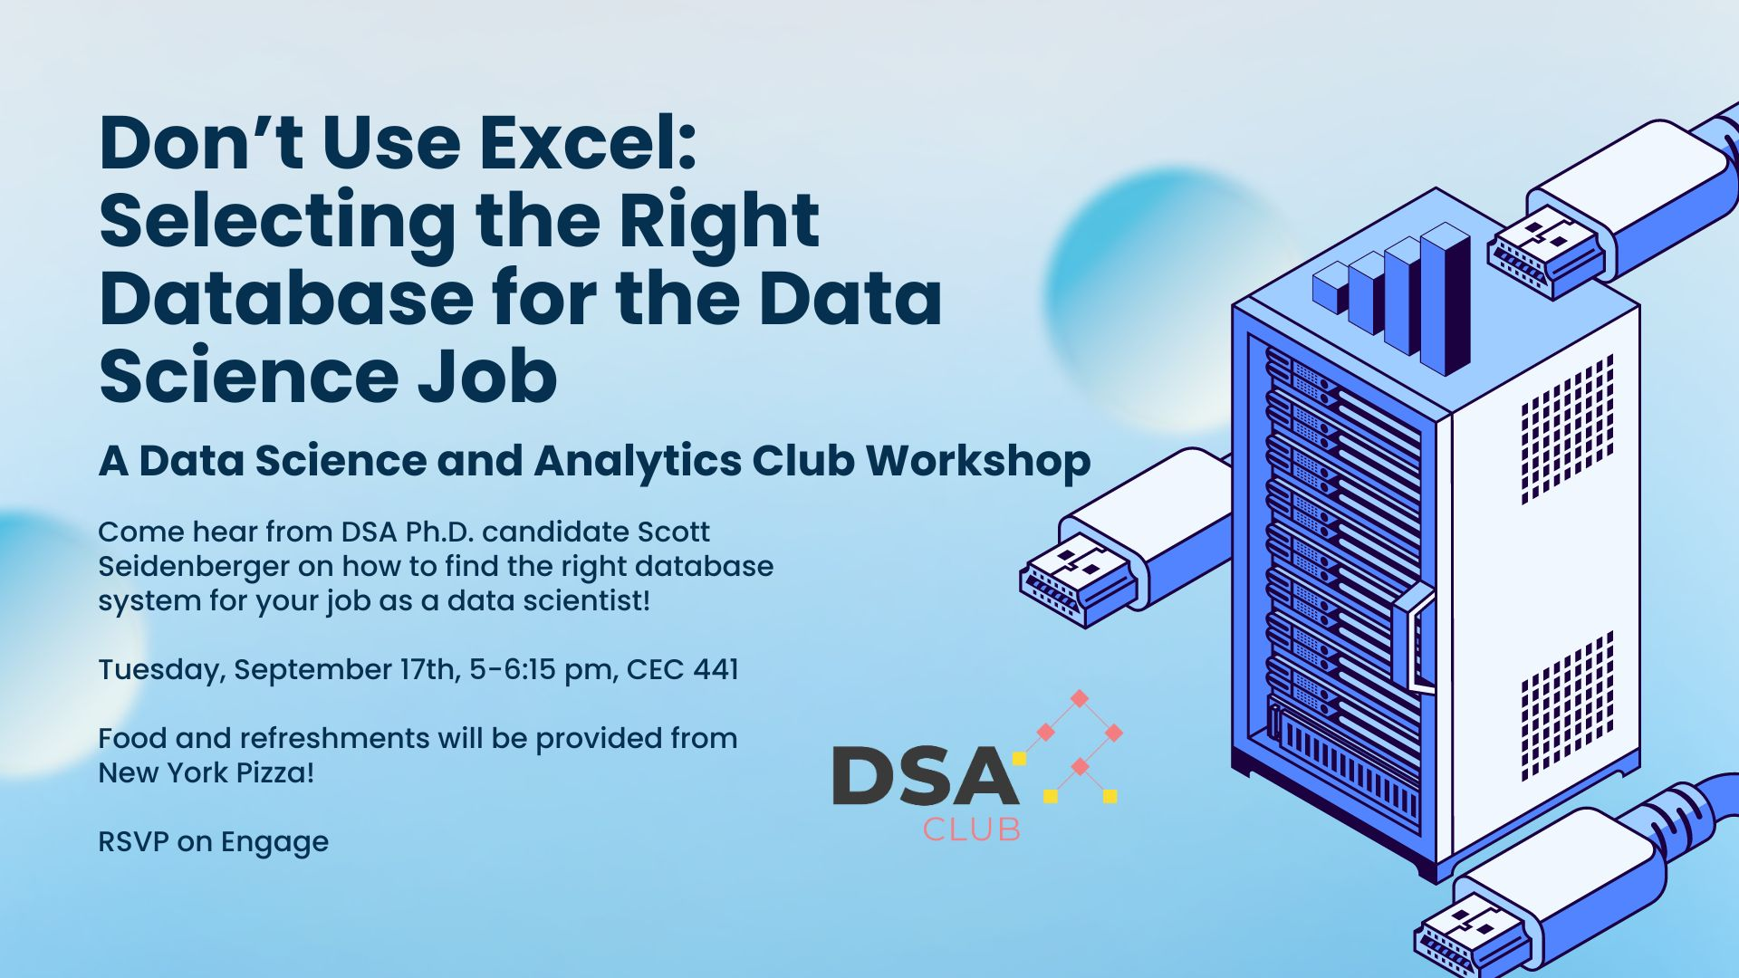
DSA Workshop: Don’t Use Excel: Selecting the Right Database for the Data Science Job
Scott Seidenberger
OU Data Science & Analytics Institute
SecretLab
seidenberger@ou.edu

Slide 2

Introduction
Scott Seidenberger
PhD Candidate
SecretLab with Dr. Maiti
Distributed systems, p2p networks, cybersecurity data science
Prior to OU, ran a small tech startup in Ethereum node operations and 7 years in the USAF
🤫

Slide 3
Why Learn Databases?
Databases are purpose-built software systems designed and implemented for various workloads.
There is the theory of databases, which is different from the practical application of databases.
Data Science relies on…data! You can’t do your job without it.
Data needs to be stored, accessed, transported, processed, analyzed, and then stored again!

Slide 4
Not my Job!?
The growing demand for managing data pipelines has led to the rise of the Data Engineer role. Shouldn’t they be the ones to care about DBs?
Data Engineer vs. Data Analyst vs. Data Scientist
Data Scientists are expected to be able to construct and conduct their own experiments, which means building data pipelines that most likely don’t yet exist!
A Data Scientist should be able to act both independently and part of a team, in both small and large orgs at varying levels of complexity.

Slide 5
A wildly oversimplified architecture
Data Scientist
User
App Server
User
User
S
C
S
C
S
C
Storage
Compute
S
C
User
User
User
S
C
S
C
S
C
Storage
Compute

Slide 6
Flat File
The most common type of data storage format in computing is the flat file. This is what most people are introduced to when starting their data science or statistics journey.
Includes common file formats like
CSV (Comma Separated Values) or Delimited (tab, semi-colon, etc.)
JSON (JavaScript Object Notation)
XML (X Markup Language)
XLSX (Excel Format)

Slide 7
Flat File vs Database
Databases create features and functionality that flat files do not have…because they are files and not software systems.
There are certain properties we desire:
CRUD (Create, Read, Update, Delete)
ACID (Atomicity, Consistency, Isolation, Durability)
Scalability
Availability
Resilience
Integrity
Remember, DBs are software systems so they can be deployed as such! Containers, cloud, serverless, the works!
Notes:
Flat files are pretty easy to work with, but if you need any of the features provided by a database, then you need a true database. The key is picking the right database with the correct level of sophistication for the job you are doing.

Slide 8
So you’re convinced you need a database, what are your options?

Slide 9
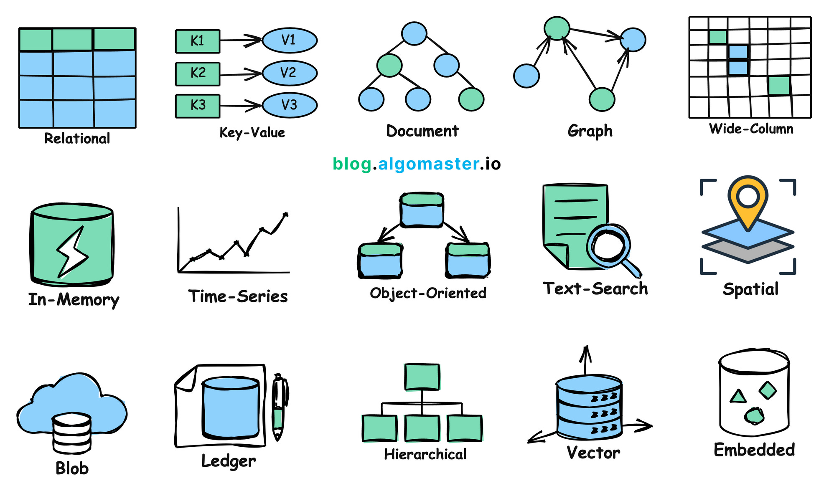
Common Database Types
SQL
NoSQL
Purpose built
Key-Value
Graph
Vector
Time Series
Blob

Slide 10
SQL
Structured Query Language
Emerged as a way to handle Relational Database architectures (RDBS)
Table Schemas are set at creation
Rows and Fixed Columns
Rows in tables can be linked to other tables via keys
MySQL
Postgres
Vertical Scaling
Transaction Guarantees (ACID)
Notes:
Vertical scaling = sharding, partitioning

Slide 11
NoSQL
Emerged as a way to handle unstructured or loosely structured data
Did away with the rigidity of SQL and relational systems
Records are represented as documents and not rows/columns
This allows them to have nested structures like you’d see in JSON
MongoDB
Elasticsearch
Horizontal Scaling
No transaction guarantees, eventual consistency*
Notes:
MongoDB allows for ACID compliance within a specific scope

Slide 12
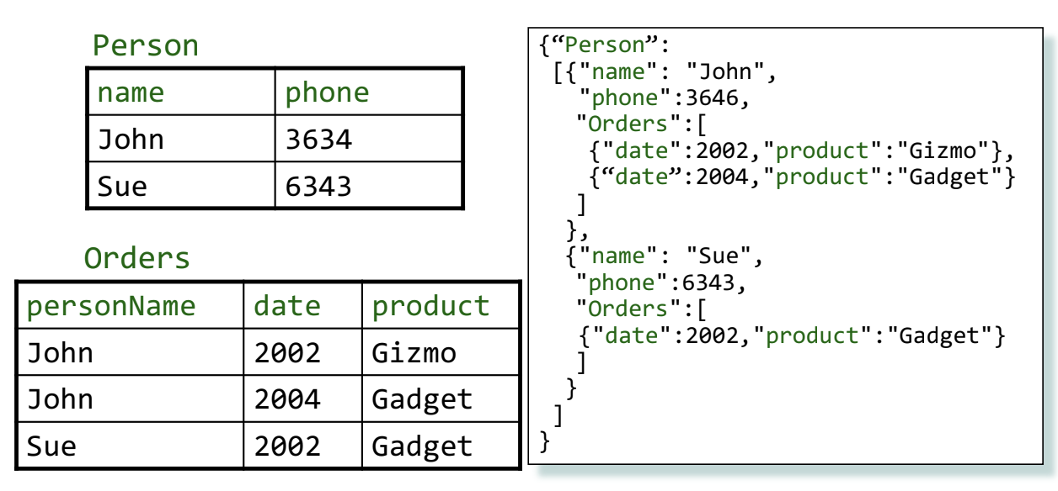
SQL vs NoSQL

Slide 13
DSA Workshop: Don’t Use Excel: Selecting the Right Database for the Data Science Job
Demo:
Performance Differences by DB vs Flatfile

